Slide 1
Pauze

Slide 2
Now lets take a small detour to get an overview of the basic picture of galaxy formation

Slide 3
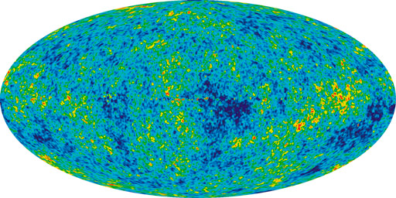
Basic Picture of Galaxy Formation
Gravitational
Collapse
2. Gas Cooling
Radiative cooling
Dark matter
＋
Ionized gas
Cold gas
Initial density fluctuation
DM halo
(w ionized gas)
Gas in DM halo
= Galaxy

Slide 4
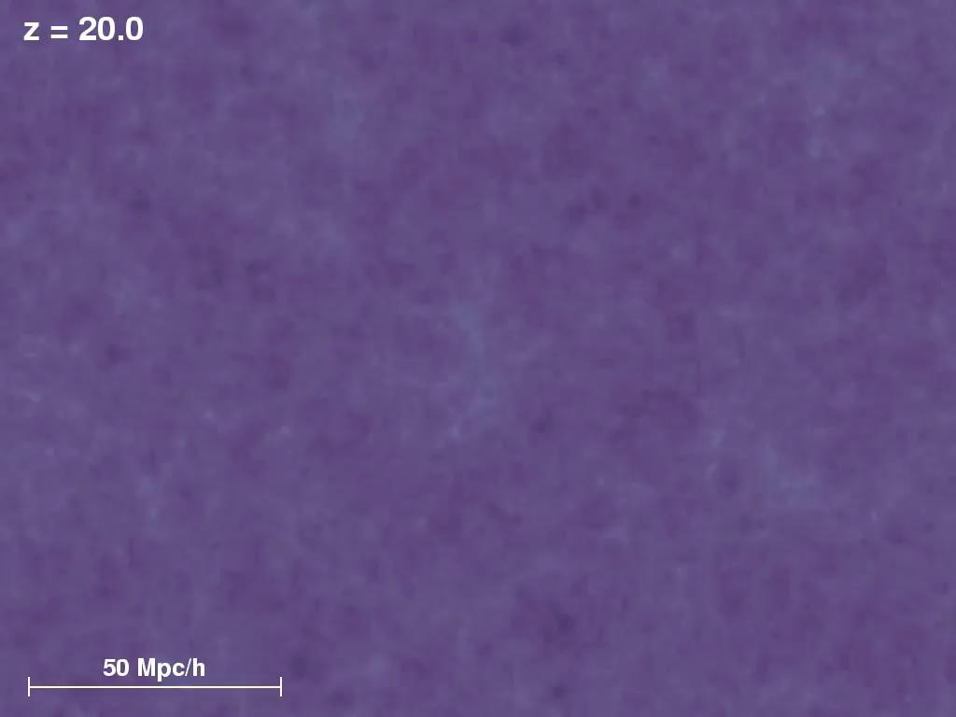
Volker Springel, Max-Plank-Institute for Astrophysics

Slide 5
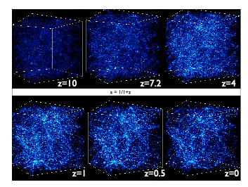

Slide 6
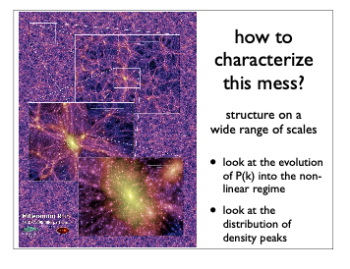

Slide 7
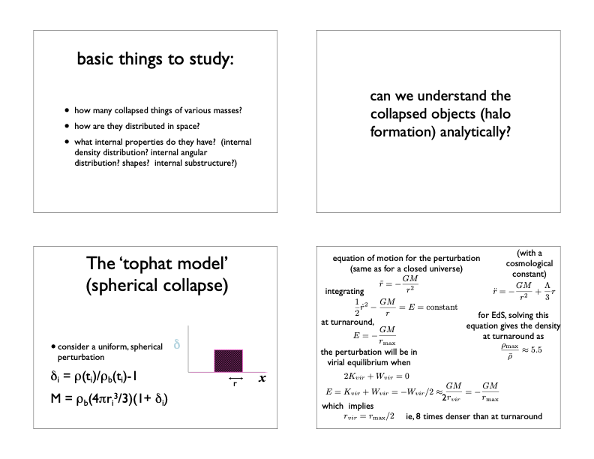

Slide 11
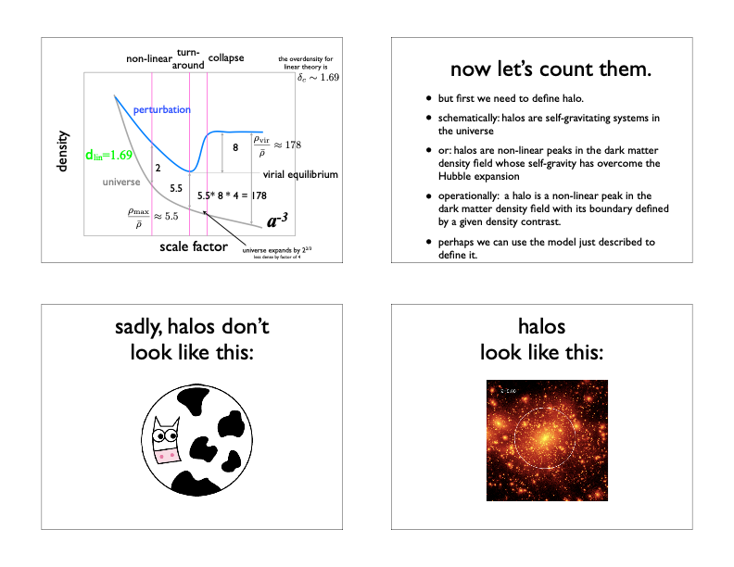

Slide 14
Basic Picture of Galaxy Formation
Gravitational
Collapse
2. Gas Cooling
Radiative cooling
Dark matter
＋
Ionized gas
Cold gas
Initial density fluctuation
DM halo
(w ionized gas)
Gas in DM halo
= Galaxy
Galaxy formation = Dark halo formation + Star-formation (K. Shimasaku)

Slide 15
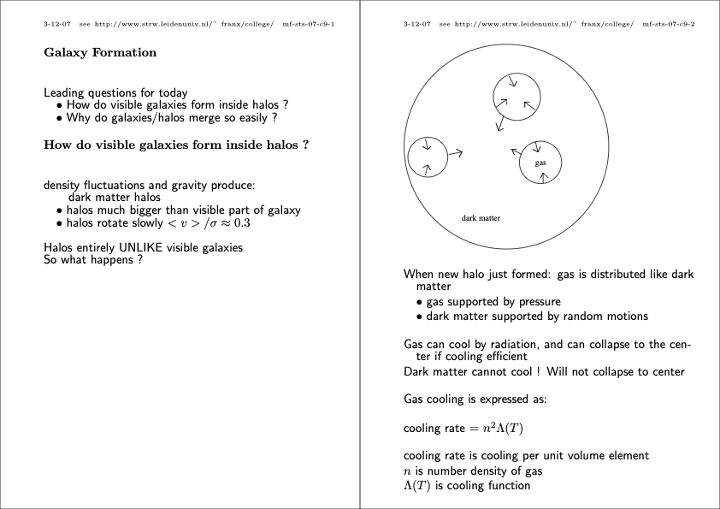
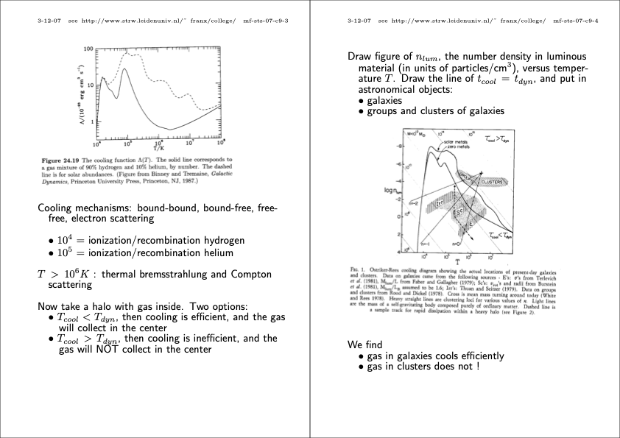
SECOND STEP: Gas cooling
The cooling rate can be expressed as
where n is the gas volume density and Λ(T) is the temperature dependent cooling rate.
Thermal Bremsstrahlung
Ionization /
Recombination Helium
Ionization /
Recombination Hydrogen

Slide 16
SECOND STEP: Gas cooling
There are two time scales of interest in thinking about galaxy formation:
(1) dynamical time scale tdyn
(∝ n^{-1/2})
(2) cooling time scale tcool (∝ n⁻² Λ⁻¹(T))
Baryons in a collapsed halo can cool quickly if the cooling time scale is
less than the dynamical time scale, i.e., tcool < tdyn
What matters is the ratio tcool / tdyn:
n^{-3/2} Λ⁻¹(T)
Is this quantity <= 1?
n^{-3/2} Λ⁻¹(T) < 1
n^{-3/2} < Λ(T)

Slide 17
SECOND STEP: Gas cooling
The cooling rate can be expressed as
where n is the gas volume density and Λ(T) is the temperature dependent cooling rate.
Can write the
equivalent
Thermal Bremsstrahlung
n^{-3/2} < Λ(T)
Ionization /
Recombination Helium
on this axis
Ionization /
Recombination Hydrogen

Slide 18
SECOND STEP: Gas cooling
The cooling rate can be expressed as
where n is the gas volume density and Λ(T) is the temperature dependent cooling rate.

Slide 19
SECOND STEP: Gas cooling
The cooling rate can be expressed as
where n is the gas volume density and Λ(T) is the temperature dependent cooling rate.

Slide 20
SECOND STEP: Gas cooling
The cooling rate can be expressed as
where n is the gas volume density and Λ(T) is the temperature dependent cooling rate.
M ∝T^{3/2} / n^{1/2}
M/R ∝ σ²
M/R ∝ T
(M/R)^{3/2} ∝ T^{3/2}
M M^{1/2}R^{3/2} ∝ T^{3/2}
M (M/R³)^{1/2} ∝ T^{3/2}
M n^{1/2} ∝ T^{3/2}
M ∝ T^{3/2} / n^{1/2}
constant mass lines

Slide 21
SECOND STEP: Gas cooling
The cooling rate can be expressed as
where n is the gas volume density and Λ(T) is the temperature dependent cooling rate.
For sources with galaxy-sized masses (10¹⁰ Msol), cooling is efficient...
However for cluster-scale masses (10¹⁴ Msol), cooling is not efficient... and have lots of hot gas.
constant mass lines

Slide 22
SECOND STEP: Gas cooling
There are two time scales of interest in thinking about galaxy formation:
(1) dynamical time scale tdyn
(∝ n^{-1/2})
(2) cooling time scale tcool (∝ n⁻² Λ⁻¹(T))
It is likely a function of the mass of gas that cools inside the collapsed halo.
For sources with galaxy-sized masses (10¹⁰ Msol), cooling is efficient...
However for cluster-scale masses (10¹⁴ Msol), cooling is not efficient... and have lots of hot gas.
constant mass lines

Slide 23
SECOND STEP: Gas cooling
There are two time scales of interest in thinking about galaxy formation:
(1) dynamical time scale tdyn
(∝ n^{-1/2})
(2) cooling time scale tcool (∝ n⁻² Λ⁻¹(T))
It is likely a function of the mass of gas that cools inside the collapsed halo.
Relevant collapsed halos ~ 10⁸ to 10^{12.5} solar masses
Baryonic Mass in these Halos
< 10¹¹ solar masses
Only a small fraction of which cools and forms stars
constant mass lines

Slide 24
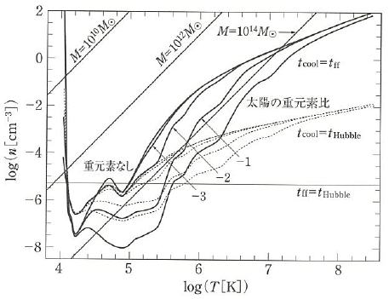
Conditions for Gas Collapse
Cooling diagram
Collapsing
t_{cool} < t_{ff}
Solar metallicity
No metal
No collapsing
t_{cool} > t_{ff}
Silk & Wyse 1993
t_{cool} < t_{ff}: Gas collapse→ dense gas/star-formation(10¹²Mo)
t_{cool} > t_{ff}: No gas collapse (quasi-static contraction)
Notes:
Virial temperature as a function of mass and radius: T=GMμm/5kR and M=3/4πR^3rho
For M=const, T^3 propto rho
For rho=const, T^3 propto M^2
For T=const, M^2 propto 1/rho

Slide 25
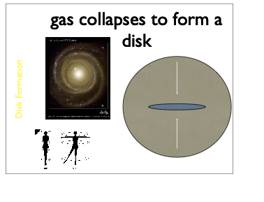
Notes:
Virial temperature as a function of mass and radius: T=GMμm/5kR and M=3/4πR^3rho
For M=const, T^3 propto rho
For rho=const, T^3 propto M^2
For T=const, M^2 propto 1/rho

Slide 26
Why does the cooling baryonic material settle into a disk?
Angular momentum of the Baryonic Material
While radiative processes can remove energy from the gas, these processes preserve its angular momentum.
This results in the formation of a gas disk (for a disk galaxy), since a disk is the minimum energy configuration that still conserves angular momentum.

Slide 27


What determines the Size of Disk Galaxies?
Likely the angular momentum of the halo
spinning slow
spinning moderate speed
spinning fast
after cooling
after cooling
after cooling
(small enough, may not be stable as disk galaxy)
intermediate size,
more dense disk galaxy
large,
lower density galaxy disk
higher surface brightness
lower surface brightness

Slide 28
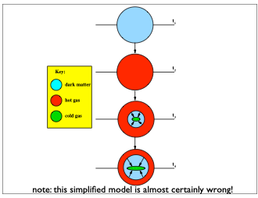
Notes:
Virial temperature as a function of mass and radius: T=GMμm/5kR and M=3/4πR^3rho
For M=const, T^3 propto rho
For rho=const, T^3 propto M^2
For T=const, M^2 propto 1/rho

Slide 29
Basic Picture of Galaxy Formation
Gravitational
Collapse
2. Gas Cooling
3. Star Formation
Dark matter
＋
Ionized gas
Cold gas
Cold gas
DM halo
(w ionized gas)
Gas in DM halo
= Galaxy
Gas + Stars in DM halo
= Galaxy
Galaxy formation = Dark halo formation + Star-formation (K. Shimasaku)

Slide 30
Star-Formation in a Gas Cloud
Star Formation Rate ∝ Cool Gas / (time scaleSF)
Divide by Area to make Surface Density
ΣSFR ∝ Σgas / (time scaleSF)
ΣSFR ∝ Σgas / tdyn
ΣSFR ∝ Σgas / (Σgas^{-0.5})
ΣSFR ∝ (Σgas )^{1.5}
Kennicutt-Schmidt Law
Kennicutt 1998
Notes:
Below 10⁴ K: Need H₂/metal cooling, to reach a few 10 K
Enough gas density→Star formation: It is not well understood…
Gas contraction by Jeans instability… What is the mass distribution of newborn stars? (e.g. IMF)

Slide 31
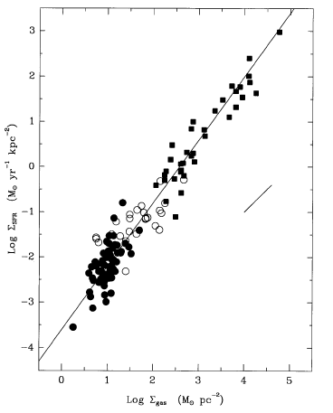
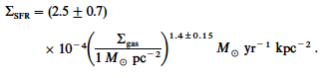
Star-Formation in a Gas Cloud
For modeling, one can use an empirical relation (obs. results) e.g.
Kennicutt-Schmidt law (Kennicutt98)
to reduce the model parameters
Kennicutt 1998
Notes:
Below 10⁴ K: Need H₂/metal cooling, to reach a few 10 K
Enough gas density→Star formation: It is not well understood…
Gas contraction by Jeans instability… What is the mass distribution of newborn stars? (e.g. IMF)

Slide 32
As the cool gas forms stars, there will be SNe explosions…
Notes:
Virial temperature as a function of mass and radius: T=GMμm/5kR and M=3/4πR^3rho
For M=const, T^3 propto rho
For rho=const, T^3 propto M^2
For T=const, M^2 propto 1/rho

Slide 33
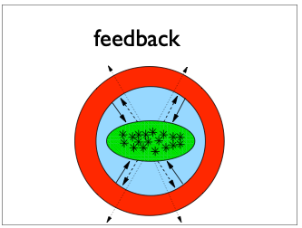

Feedback from Supernova Explosions
Notes:
Virial temperature as a function of mass and radius: T=GMμm/5kR and M=3/4πR^3rho
For M=const, T^3 propto rho
For rho=const, T^3 propto M^2
For T=const, M^2 propto 1/rho

Slide 34
What happens when two halos with galaxies at the
center merge?
Notes:
Virial temperature as a function of mass and radius: T=GMμm/5kR and M=3/4πR^3rho
For M=const, T^3 propto rho
For rho=const, T^3 propto M^2
For T=const, M^2 propto 1/rho

Slide 35
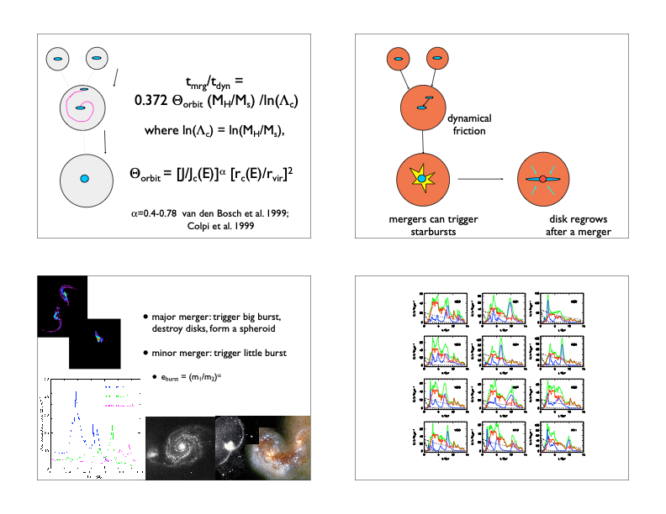
What happens when two halos with galaxies at the
center merge?
Notes:
Virial temperature as a function of mass and radius: T=GMμm/5kR and M=3/4πR^3rho
For M=const, T^3 propto rho
For rho=const, T^3 propto M^2
For T=const, M^2 propto 1/rho

Slide 36
Notes:
Virial temperature as a function of mass and radius: T=GMμm/5kR and M=3/4πR^3rho
For M=const, T^3 propto rho
For rho=const, T^3 propto M^2
For T=const, M^2 propto 1/rho

Slide 37
Notes:
Virial temperature as a function of mass and radius: T=GMμm/5kR and M=3/4πR^3rho
For M=const, T^3 propto rho
For rho=const, T^3 propto M^2
For T=const, M^2 propto 1/rho

Slide 38
Notes:
Virial temperature as a function of mass and radius: T=GMμm/5kR and M=3/4πR^3rho
For M=const, T^3 propto rho
For rho=const, T^3 propto M^2
For T=const, M^2 propto 1/rho

Slide 39
gas cooling again!
Notes:
Virial temperature as a function of mass and radius: T=GMμm/5kR and M=3/4πR^3rho
For M=const, T^3 propto rho
For rho=const, T^3 propto M^2
For T=const, M^2 propto 1/rho

Slide 40
Gravitationally collapsed
sources continue to grow…
even after the nominal
spherical collapse…
Notes:
Below 10⁴ K: Need H₂/metal cooling, to reach a few 10 K
Enough gas density→Star formation: It is not well understood…
Gas contraction by Jeans instability… What is the mass distribution of newborn stars? (e.g. IMF)

Slide 41
How might we expect a
collapsed source to behave
as it grows in mass?
Notes:
Below 10⁴ K: Need H₂/metal cooling, to reach a few 10 K
Enough gas density→Star formation: It is not well understood…
Gas contraction by Jeans instability… What is the mass distribution of newborn stars? (e.g. IMF)

Slide 42
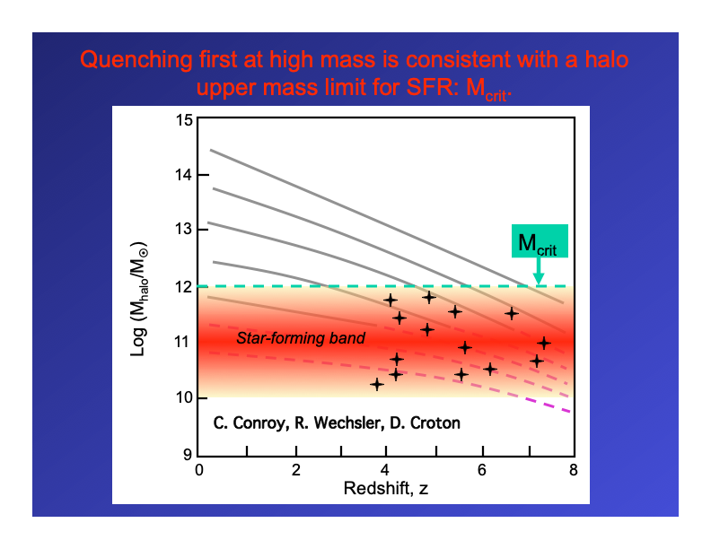
Growing Collapsed Halos Move through Star-Forming Band

Slide 43
What happens as galaxies build up in mass?
Notes:
Below 10⁴ K: Need H₂/metal cooling, to reach a few 10 K
Enough gas density→Star formation: It is not well understood…
Gas contraction by Jeans instability… What is the mass distribution of newborn stars? (e.g. IMF)

Slide 44
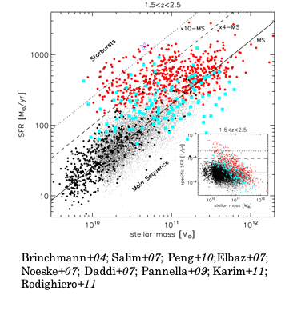
Star Formation
Rate
roughly
proportional
to
Stellar Mass
Earlier Heard
Proportional
Gas Mass
Notes:
Below 10⁴ K: Need H₂/metal cooling, to reach a few 10 K
Enough gas density→Star formation: It is not well understood…
Gas contraction by Jeans instability… What is the mass distribution of newborn stars? (e.g. IMF)

Slide 45
Called
Main
Sequence of
Star Formation
in Galaxies
Starbursts
Above
Sequence
Notes:
Below 10⁴ K: Need H₂/metal cooling, to reach a few 10 K
Enough gas density→Star formation: It is not well understood…
Gas contraction by Jeans instability… What is the mass distribution of newborn stars? (e.g. IMF)

Slide 46
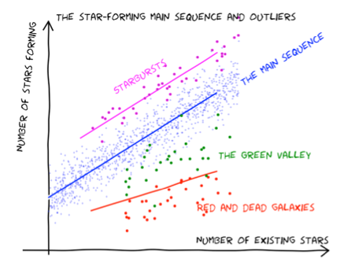
Notes:
Below 10⁴ K: Need H₂/metal cooling, to reach a few 10 K
Enough gas density→Star formation: It is not well understood…
Gas contraction by Jeans instability… What is the mass distribution of newborn stars? (e.g. IMF)

Slide 47
Does the main
sequence of star formation in galaxies evolve?
Notes:
Below 10⁴ K: Need H₂/metal cooling, to reach a few 10 K
Enough gas density→Star formation: It is not well understood…
Gas contraction by Jeans instability… What is the mass distribution of newborn stars? (e.g. IMF)

Slide 48
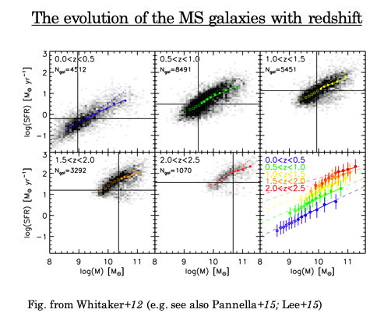
Notes:
Below 10⁴ K: Need H₂/metal cooling, to reach a few 10 K
Enough gas density→Star formation: It is not well understood…
Gas contraction by Jeans instability… What is the mass distribution of newborn stars? (e.g. IMF)

Slide 49
Evolution likely due to
evolution in accretion
rate of gas across
cosmic time…
Notes:
Below 10⁴ K: Need H₂/metal cooling, to reach a few 10 K
Enough gas density→Star formation: It is not well understood…
Gas contraction by Jeans instability… What is the mass distribution of newborn stars? (e.g. IMF)

Slide 50
Notes:
Below 10⁴ K: Need H₂/metal cooling, to reach a few 10 K
Enough gas density→Star formation: It is not well understood…
Gas contraction by Jeans instability… What is the mass distribution of newborn stars? (e.g. IMF)

Slide 51
This relation is mirrored
when looking at galaxies
as a function of color…
Notes:
Below 10⁴ K: Need H₂/metal cooling, to reach a few 10 K
Enough gas density→Star formation: It is not well understood…
Gas contraction by Jeans instability… What is the mass distribution of newborn stars? (e.g. IMF)

Slide 52
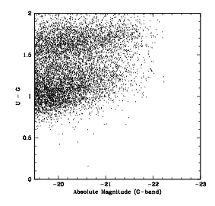
When Dividing Galaxies by Color, One Sees a Bimodal Relation
Galaxies whose colors lie
on “red sequence”
Galaxies whose colors lie within the “blue cloud”
“red sequence”
“green valley”
color
“blue cloud”
luminosity
There is a clear bimodality to the distribution!

Slide 53
Observational Fact:
Galaxies are found
to be blue and star-forming
or
red and non-star-forming
Notes:
Below 10⁴ K: Need H₂/metal cooling, to reach a few 10 K
Enough gas density→Star formation: It is not well understood…
Gas contraction by Jeans instability… What is the mass distribution of newborn stars? (e.g. IMF)

Slide 54
Growing Collapsed Halos Move through Star-Forming Band
Star-Formation
stops due to quenching
process
Quenching perhaps
due to energy output
from AGN at center of galaxies?

Slide 55
So how does this fit into shaping our observed Universe?

Slide 56
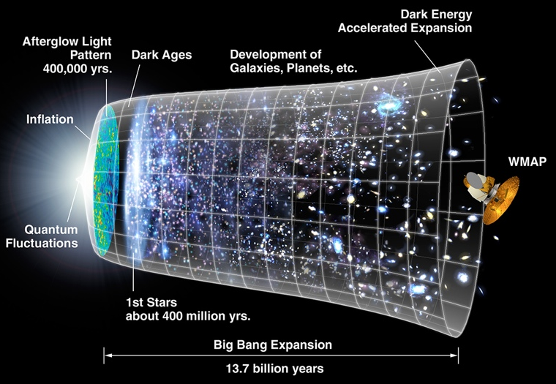
Reionization of the Universe
Are galaxies responsible for bringing about reionization?
Reionization
First
Stars
First
Galaxies
Normal
Galaxies
Now
Synthesis
of Elements
Recombination
BIG BANG
10⁻¹⁴
0.0003
0.2
0.4 0.7
1 2 3 13.7
Age of Universe
Billions of Years (Gyr)

Slide 57
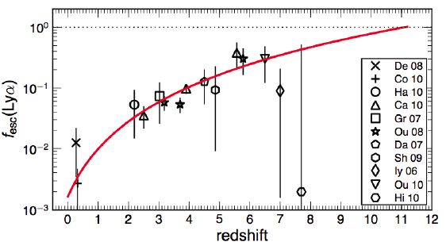
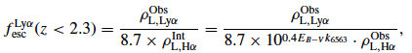
Lyα Escape Fraction f_{esc}(Lyα) Evolution
Hayes et al. (2011)
Assuming Case B recombination
f_{esc}(Lyα) shows a monotonic increase up to z~6

Slide 58

Stellar populations played a fundamental role in the evolutionary processes in the universe

Slide 59
Video removed due to github file size restrictions
This can be downloaded from here: http://icc.dur.ac.uk/Eagle/downloads.php

Slide 60
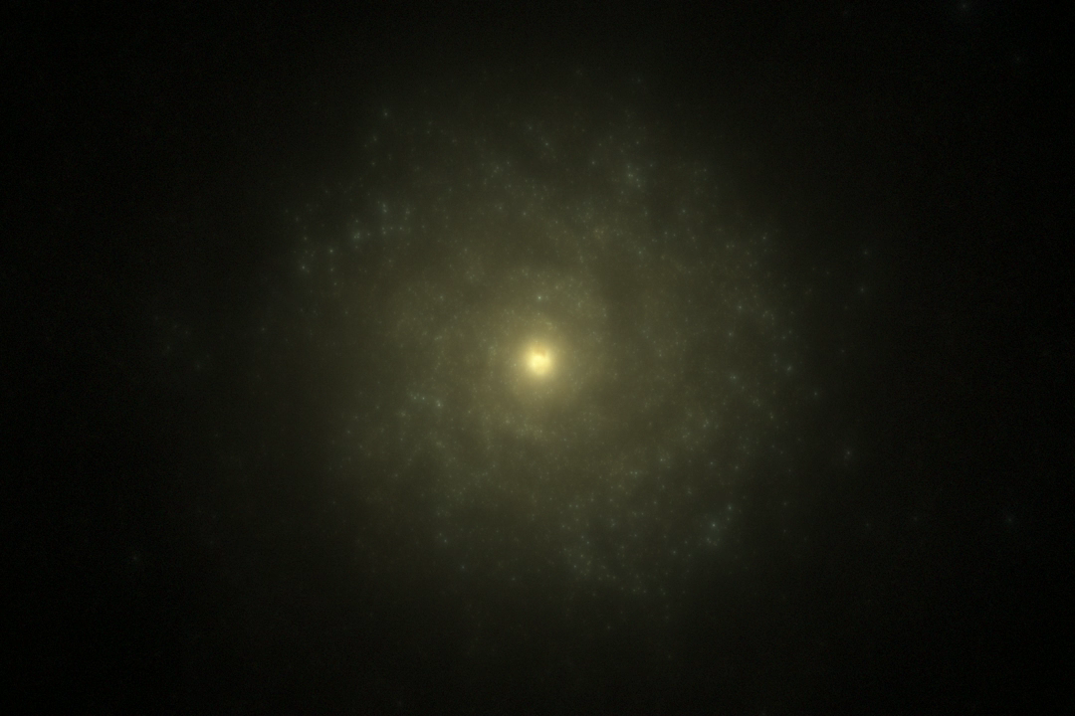
©EAGLE

Slide 61
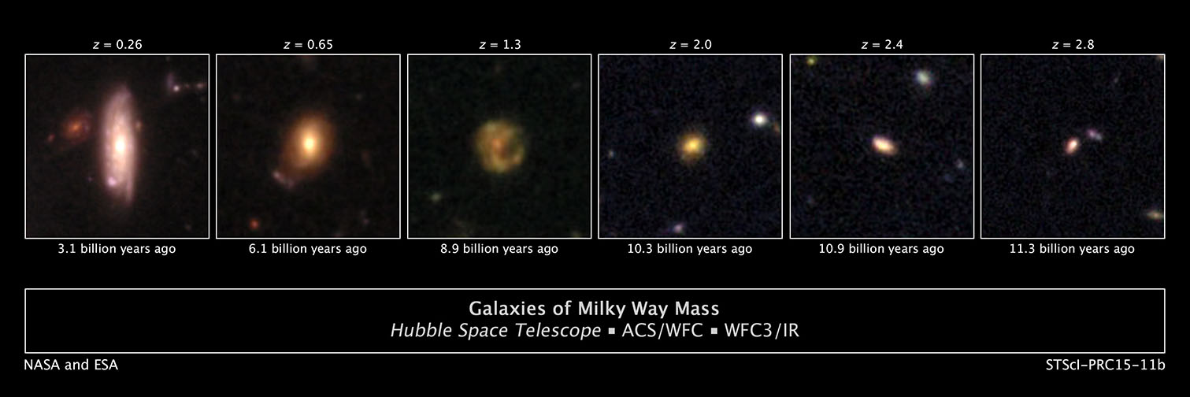
Tracking the evolution of the universe
redder dust-obscured IR-luminous galaxies
blue, star-forming disk galaxies
quiescent galaxies
Notes:
The typical MW-mass and M31-mass progenitors passed through the same evolution stages, evolving from blue, star-forming disk galaxies at the earliest stages to redder dust-obscured IR-luminous galaxies in intermediate stages and to red, more quiescent galaxies at their latest stages. The progenitors of the MW-mass galaxies reached each evolutionary stage at later times (lower redshifts) and with stellar masses that are a factor of two to three lower than the progenitors of the M31-mass galaxies. The process driving this evolution, including the suppression of star formation in present-day M∗ galaxies, requires an evolving stellar-mass/halo-mass ratio and/or evolving halo-mass threshold for quiescent galaxies. The effective size and SFRs imply that the baryonic cold-gas fractions drop as galaxies evolve from high redshift to z ∼ 0 and are strongly anticorrelated with an increase in the Se ́rsic index. Therefore, the growth of galaxy bulges in M∗ galaxies corresponds to a rapid decline in the galaxy gas fractions and/or a decrease in the star formation efficiency.

Slide 62
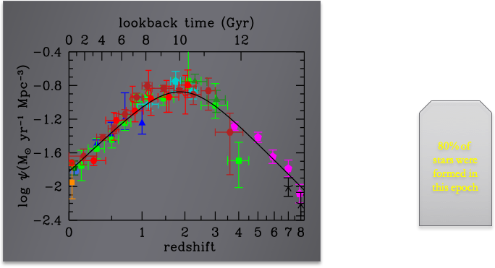

80% of stars in the universe were formed between 1<z<3
galaxies are young, actively forming stars & rapidly evolving
80% of
mass
©Madau2014

Slide 63
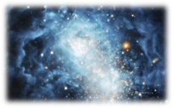
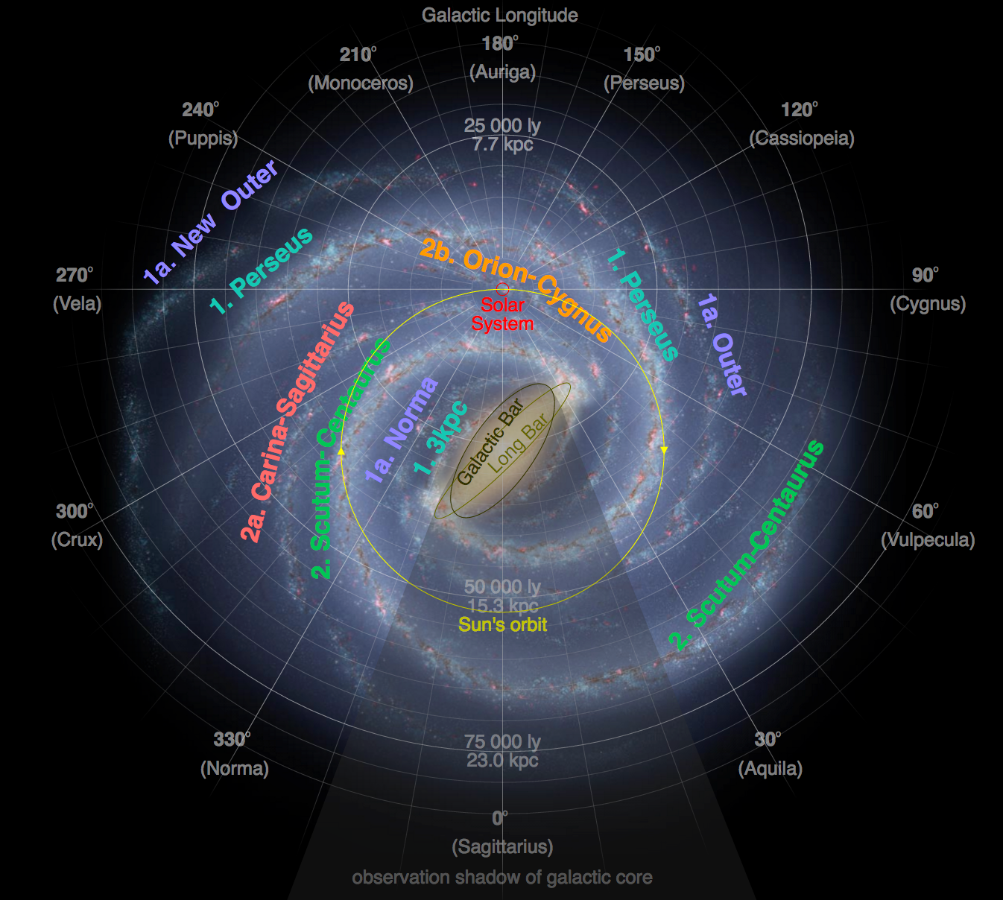
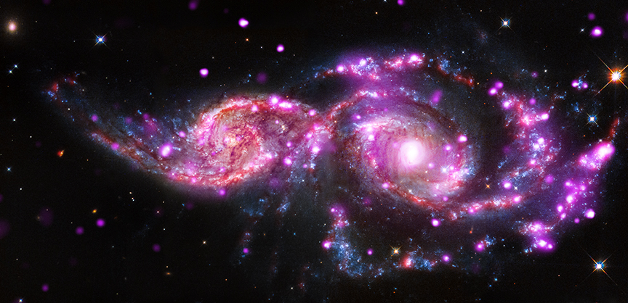
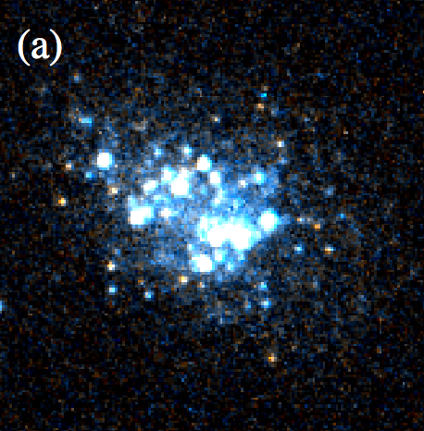
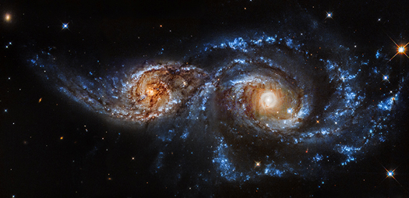
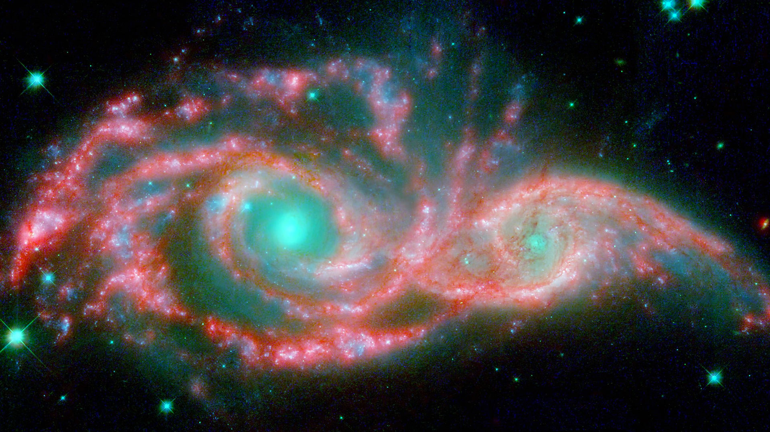
Stars are formed in local regions within galaxies in various physical/environmental/chemical conditions
©Hirschauer2016
©HST
©Hurt
Notes:
env—> interaction between gas clouds lead to extra UV flux, strong winds, powerful outflows—> suppress low mass stars increasing cloud surface densities leading to radiation trapping favours the formation of high mass stars.

Slide 65
The present day Universe

Slide 67
Questions for groups
GROUP 1
Define and describe the "tired light hypothesis" and the "steady state universe" as alternatives to the Big Bang. How have they been disproved observationally?
Sketch out the Hubble sequence. What physical trends are captured by the classification system?
GROUP 2
What is the 'fine tuning problem’? How do anthropic arguments attempt to resolve it?
What is the density-morphology relation for galaxies? How is that related to what we know about the relationship between galaxy density and star formation rates in galaxies?
GROUP 3
What happened in the first 3 minutes after the Big Bang? Why is only He (and tiny traces of Li) synthesized in the Big Bang?
What evidence is there that most galaxies contain super massive black holes? How do those black holes interact with their host galaxies?
GROUP 4
What is cosmological inflation? List three important observations which it is intended to explain.
What is a stellar Initial Mass Function (IMF)? Sketch it. Give a couple of examples of simple parametric forms used to describe the IMF.
Notes:
Group 1
Tired light: http://www.astro.ucla.edu/~wright/tiredlit.htm
Steady state: http://www.astro.ucla.edu/~wright/stdystat.htm
Hubble sequence:
Group 2
Fine tuning: Martin Rees and 6 params https://en.wikipedia.org/wiki/Fine-tuned_Universe
Morphology density relation: http://astronomy.swin.edu.au/cosmos/M/Morphology+Density+Relation
Group 3
3 min of Big Bang: https://www.physicsoftheuniverse.com/topics_bigbang_timeline.html
SMBH: http://science.sciencemag.org/content/300/5627/1898
Group 4
Inflation: Needed to explain horizon problem, magnetic monopole, flatness problem
Show Simon Drivers slides
IMF: Baldry plot

